Slide 1

Devops
By
Jitin Singh
Notes:
Welcome everyone to this demo session on Devops tutorial. Before I begin guys, Let me introduce myself.
0:09
My name is Jitin and I have experience working on various develop solutions for different companies. I've worked on quite a lot of devops till starting
0:16
from Git, Jenkins, Docker, Puppet, Ansible. So this is about me guys and in today's session we are going to focus
0:23
on various stages and tools involved in devops. And what exactly is the meaning of devops methodology.
0:29
So let's move forward and have a look at the agenda for today. So this is what we'll be discussing today

Slide 2
Topic for Today’s Session
Why DevOps?
What is DevOps
DevOps Stages
DevOps Tools
DevOps Use-Case
Notes:
So this is what we'll be discussing today. We'll Begin by understanding why we need devops
0:35
everything exists for a reason. So we'll try to figure out that reason we are going to see what are the various limitations of the traditional software delivery methodologies
0:42
and how devops overcomes all of those limitations. Then we are going to focus on what exactly is a DevOps methodology
0:48
and what are the various stages and tools involved in devops. And then finally in the hands on part I will tell you how you can create a Docker image
0:55
how you can build it test it and even push it onto Docker Hub in an automated fashion. Using Jenkins.
1:01
So I hope you all are clear with the agenda. Kindly give me a quick confirmation by writing down in the chat box.

Slide 3
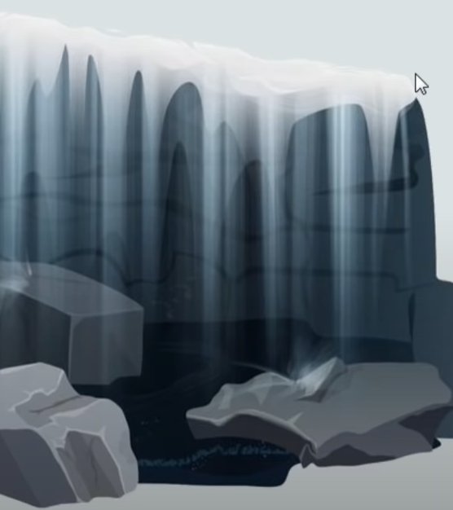
Waterfall Model
It has a distinct goals of each phase of development. Imagine a waterfall on the cliff of a steep mountain. Once the water has flowed over the edge of the cliff, it cannot turn back.
Notes:
So guys, let's start with the waterfall model. Now before devops organizations were using this particular software development methodology.
1:25
It was first documented in the year 1970 by Royce and was the first public documented life cycle model
1:32
the waterfall model describes a development method that is linear and sequential…..waterfall development has distinct goals
1:40
for each phase of development. Now, you must be thinking why the name waterfall model because it's pretty similar to a waterfall.
1:46
Now what happens in a waterfall once the water has flowed over the edge of the cliff. It cannot turn back… the same
1:52
is the case for waterfall development strategy as well and application will go to the next stage only when the previous stage is complete.
1:58
So let us focus on what are the various stages involved in waterfall methodology. So notice the diagram that is there in front of your screen

Slide 4
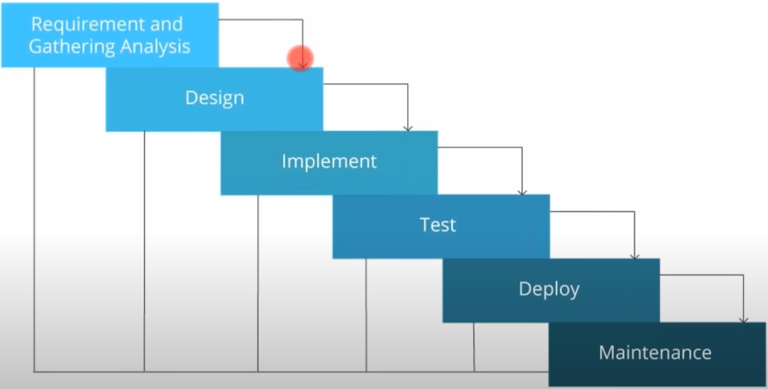
Traditional Waterfall Model
Notes:
if you notice it's almost like a Follow, you can even visualize it as a ladder as well…. the first
2:10
what happens the client gives requirement for an application. So you gather that requirement and you try to analyze it then
2:16
what happens you design the application how the application is going to look like. Then you start writing the code
2:21
for the application and you build it ….when I say build… it involves multiple steps.. like compiling your application,
2:27
you know unit testing even it involves packaging is well after that it is deployed onto the test servers for testing
2:33
and then deployed onto the processor which will release and once the application is life. It is monitored.
2:38
Now. I know this small looks perfect and trust me guys. It was at that time, but think about it what will happen
2:44
if we use it now fine. Let me give you a few disadvantages of this model. So here are a few disadvantages.

Slide 5
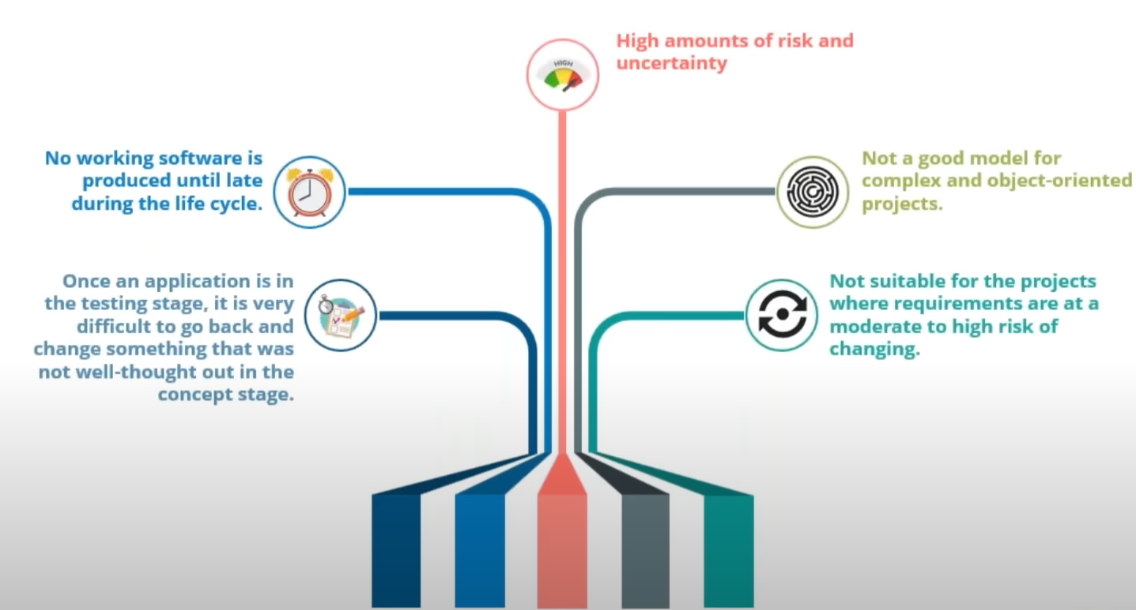
Limitations of Waterfall Model
Notes:
So first one is once the application is in the testing stage. It is very difficult to go back and change something
2:55
that was not well thought out in the concept stage now what I mean by that suppose you have written the code for the entire application,
3:01
but in testing there's some bug in that particular application….. now in order to remove that bug you have To go
3:07
through the entire source code of the application which used to take a lot of time, right?
3:12
So that is one very big limitation of waterfall model apart from that. No working software is produced until late during the life cycle.
3:19
We saw that when we are discussing about various stages of what you call more. There are high amount of risk and uncertainty which means
3:25
that once your product is live…. it is there in the market then if there is any bug or any downtime,
3:31
then you have to go through the entire source code of the application again, you have to go through that entire process of waterfall model
3:38
that we just saw in order to produce a working software again, right? So that's how it used to take.
3:43
A lot of time. There's a lot of risk and uncertainty and imagine if you have upgraded some software stack in your production environment
3:50
and that led to the failure of your application….. now to go back to the previous table version
3:55
used to also take a lot of time now, it is not a good model for complex and object oriented projects and it is not suitable for the Project's
4:03
where requirements are at a moderate to high risk of changing. So what I mean by that Suppose your client
4:09
has given you a requirement for a web application today. Now, you have taken your own sweet time
4:14
and you are going to condition the release the application say after one year now after one year,
4:19
the market has changed. The client does not want a web application. He's looking for a mobile application now,
4:25
so this type of model is not suitable where requirements are at a moderate to high risk of changing.
4:32
One should asks a question? Is all the iteration in the waterfall model goes through all the stages.
4:39
Well, there are no iteration as such . First of all, it is not agile methodology or develops.
4:44
It is waterfall model, right? There are no I trations once the stage is complete then only it will be good.
4:50
It will be going to the next stage. So there are no I trations as such if you're talking about the application
4:56
and it is life and then there is some bug or there is some downtime then at that time based on the kind of bug,
5:01
which is there in the application Suppose. There might be a bug because of some flawed version of a software.
5:07
I install in your production environment. Probably some upgraded version because if that your application is not working properly.
5:13
So you need to roll back to the previous table version of the software stack in your production environment. So that can be one bug apart from that.
5:19
There might be bugs related to the code in which you have to check the entire source code of the application again now
5:25
if you look at it to roll back and incorporate the feedback that you have got is used to take a lot of time right?
5:32
5:42
So I hope you have understood what was the traditional waterfall model. What are the various limitations of this waterfall model.
5:48
Now we are going to focus on the next methodology that is called the agile methodology. Now agile methodology is a practice
5:55
that promotes countenance iteration of development and testing throughout the software development life cycle
6:00
of the project.

Slide 6
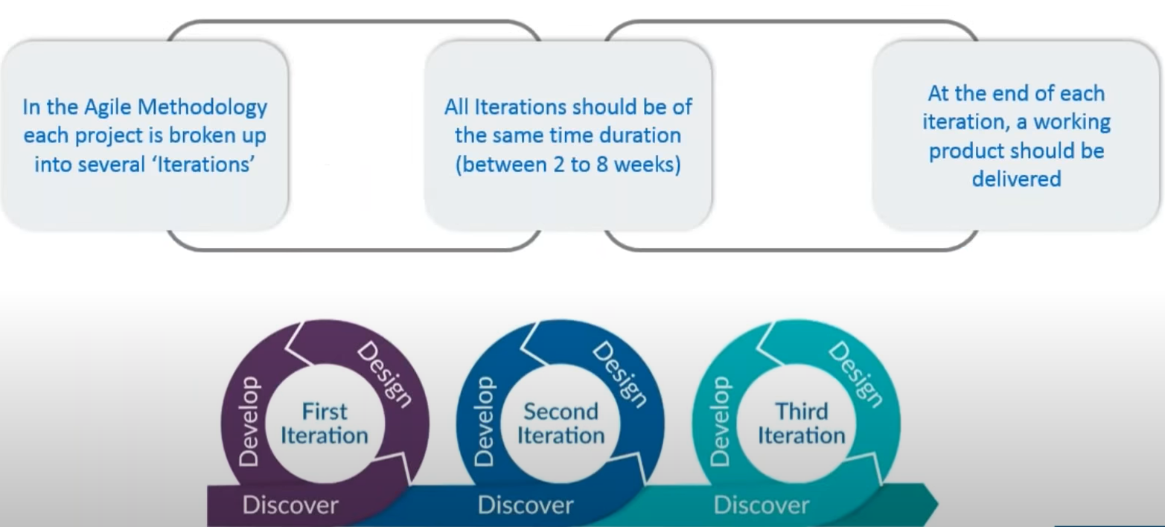
What is Agile Methodology?
Notes:
So the development and the testing of an application used to happen continuously with the agile methodology.
6:06
So what I mean by that if you focus on a diagram that is there in front of your screen, so here we get the feedback from the testing
6:12
that we have done in the previous iteration. We design the application again, then we develop it then again, we tested then we discover few things
6:18
that we can incorporate in the application. We again design it develop it and there are multiple I trations involved in development
6:25
and testing of a particular application agile methodology. Each project is broken up into several iterations
6:31
and all I tration should be of the same time duration, and generally it is between 2 to 8 weeks
6:36
and at the end of each iteration of working for dr. Hsu Be delivered. So this is what agile methodology in a nutshell
6:42
is now let me go ahead and compare this with the waterfall model. Now if you notice in the diagram that is there in front of a screen.
6:48
So waterfall model is pretty linear and it's pretty straight as you can see from the diagram that we analyze requirements.

Slide 7
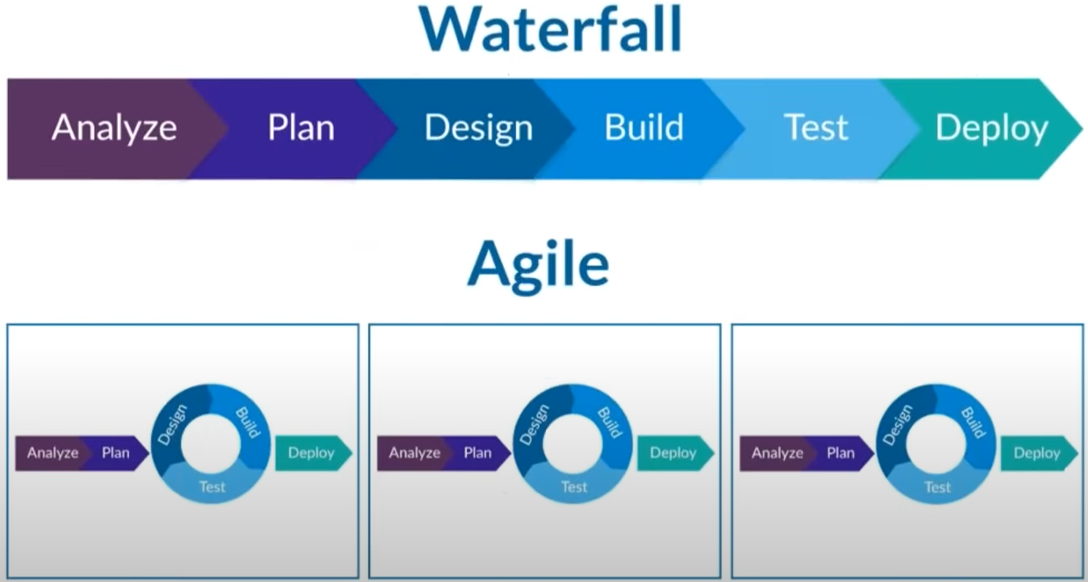
Waterfall vs Agile
Notes:
In waterfall model ..We plan it design. It build it test it. And then finally we deploy it onto the processor was for release,
6:59
but when I talk about the agile methodology over here the design build and testing part is happening continuously.
7:06
We are writing the code. We are building the application. We are testing it continuously and there are several iterations involved in this particular stage.
7:13
And once the final testing is done it is then deployed onto the broad service for release, right?
7:18
So agile methodology basically breaks down the entire software delivery life cycle into small sprains or iterations
7:24
that we call it due to which the development and the testing part of the software delivery life cycle
7:30
used to happen continously. So I hope you have understood this if you have any questions or doubts related to body follow resign

Slide 8
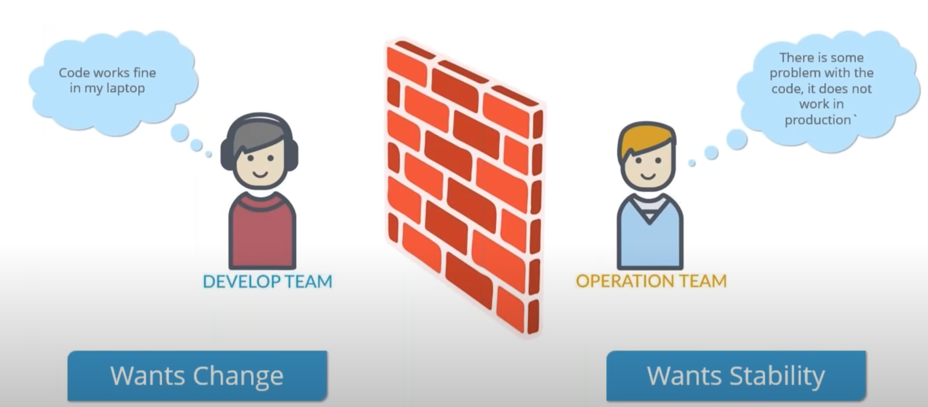
Limitations of Agile
Notes:
Let's move forward and we are going to focus on what are the various limitations of agile methodology the first
7:46
and the biggest limitation of agile methodology is that….the dev part of the team was pretty agile right…the development
7:53
and testing used to happen continuously. But when I talk about deployment then that was not continuous there were still a lot
8:00
of conflicts happening between the Dev and ops off side of the company the dev team wants agility.
8:05
Whereas the Ops Team want stability and there's a very common conflict that happens and a lot of you can actually relate to it…
8:11
that the code works fine in the developers laptop, but when it reaches to production there is some bug in the application
8:17
or it does not work any production at all. So this is because if you know some inconsistency in the Computing environment
8:23
that has caused that and due to which the operations team and the dev team used to fight a lot. There are a lot of conflicts guys at that time happening.
8:30
So agile methodology made the dev part of the company pretty agile, but when I talk about the ops side of the company,
8:36
they needed some solution in order to solve the That I've just discussed right? So I hope you are able to understand what kind
8:43
of a problem I'm focusing on. If you go back to the previous diagram as well so over here if you notice only the design build
8:49
and test or you can say Development building and testing part is continuous, right the deployment is still linear.
8:56
You need to deploy it manually on to the various process servers. That's what you was happening in the agile methodology.
9:02
Right? So the error that I was talking about you too busy. Our application is not working fine. I mean once your application is live
9:08
and you do some software stack in the production environment. It doesn't work properly now to go back and change something
9:15
in the production environment used to take a lot of time. For example, you know, you have upgraded some particular software stack
9:21
and because of that your application is not all working it fails to work now to go back to the previous table version of the software stack
9:28
the operations team was taking a lot of time because they have to go through the login scripts that they have written on in order to provision the infrastructure.
9:35
So I hope you all are getting my point . A question pops in my mind whatTypes of projects is good for agile methodology
9:41
and what types of projects are good for waterfall model. it's very interesting question.
9:47
So let me tell you when you talk about waterfall model now when I talk about waterfall model, so it is suitable for the Project's
9:53
where requirements are not at a moderate to high risk of changing, right the requirements are pretty static.
10:00
So that is suitable for waterfall model when you talk about agile. So if you are in your application is
10:05
at a moderate risk of changing then you can go ahead and use agile methodology as well
please go ahead and ask whatever doubts you have in your mind.
10:16
You won't even enjoy it if it's a one-way conversation. So feel free to ask me any questions any doubts guys fine.
10:22
So let me just give you a quick recap of the things that we have discussed till now, we have discussed coils out of his tree we started
10:28
with the waterfall model the traditional waterfall model be understood what are its various stages and what are the limitations of this waterfall mode?
10:35
Then we went ahead and understood what exactly the design methodology and how is it In from the waterfall model and what
10:41
are the various limitations of the agile methodology?

Slide 9
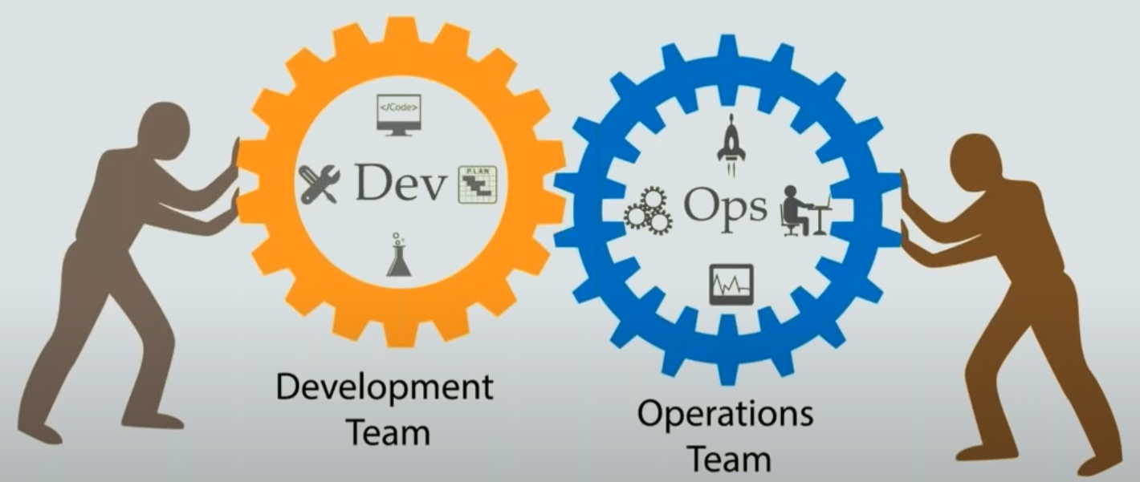
Solution is DevOps
Notes:
So this is what we have discussed till now now we are going
10:46
to look at the solution to all the problems that we have just discussed and the solution is none
10:51
other than Devops… DevOps is basically a software development strategy which Bridges the gap between the dev side
10:58
and the ops side of the company. So devops is basically a term for a group of Concepts
11:03
that while not all new have catalyzed into a movement and a rapidly spreading throughout the technical community
11:10
like any new and popular term people may have confused and sometimes contradictory impressions of what it is.
11:17
So let me tell you guys devops is not a technology. It is a methodology. So basically devops is a practice
11:23
that equated to the study of building evolving and operating rapidly changing systems at scale.

Slide 10
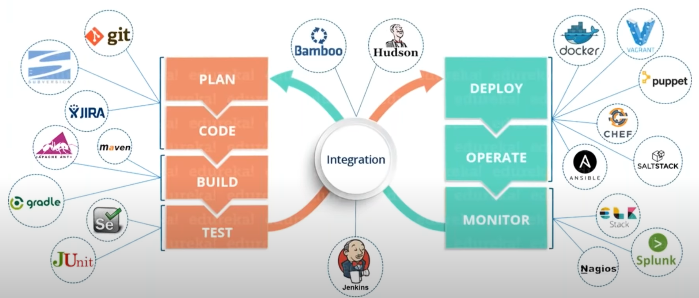
What is DevOps?
Notes:
Now. Let me put this in simpler terms. So devops is the practice of operations and development Engineers
11:35
participating together in the entire software life cycle. From design through the development process
11:41
to production support and you can also say that devops is also characterized by operation staff making use many
11:48
of the same techniques as Developers for this system work. I'll explain you that how is this definition relevant?
11:55
Because all we are saying here is devops is characterized by operation staff making use many of the same techniques
12:02
as Developers for their systems work seven. I will explain you infrastructure as code you'll understand why
12:07
I am using this particular definition, right? So as you know, that devops is a software development strategy
12:13
which Bridges the gap between the dev part in the off side of the company and helps us to deliver good quality software end time
12:19
and how this happens this happens because of various stages and tools involved in Des Moines. So here is a diagram
12:25
which is nothing but an infinite Loop because everything happens continuously in Dev Ops guys,
12:30
everything starting from coding testing deployment monitoring everything is happening continuously,
12:36
and these are the various tools which are involved in Devops methodologic, right?
12:41
So not only the knowledge of these tools are important for a devops engineer, but also how to use these tools.
12:47
How can I architect my software delivery lifecycle such that I get the maximum output right?
12:53
So it doesn't mean that, you know, if I have a good knowledge of Jenkins or gate or darker, then I become a DevOps engineer.
12:59
No that is not true. You should know how to use them. You should know where to use them to get the maximum output.
13:05
So I hope you have got my point what I'm trying to say here. If you have any questions any doubts, just go ahead and ask me
in the next slide.
13:12
I will be discussing about various stages that are involved in devops, but before that if you have any questions, please go ahead and ask me.
13:20
One more question…. Does organization uses all the tools?
13:27
for different stages know they'll be using one tool per stage or there might be multiple tools but there's no guarantee
13:33
that they'll use all the tools that I mentioned in my particular slide right based on their requirement based on the kind of application
13:39
that they have they can go ahead and configure their entire software delivery life cycle the way they want.
13:46
what are the tools covered in the syllabus? So there are multiple tools
13:52
which will be covered in the syllabus for one stage. There might be one or multiple tools available. For example, there is ansible as well as the chef
13:59
and puppet available in the course and all of them are configuration management tools when I talk about source code management,
14:05
then we have covered git for building an application. There is mavin for continuously testing we have selenium
14:10
and we even have Docker for containerization as well and Jenkins is the heart of DevOps life cycle. So we have chosen Jenkins
14:16
as well in the course why we have chosen these tools is Because they have the major market share right apart from that.
14:22
Most of the companies have given good reviews about these tools. These are open source tools and pretty trending right now
14:28
and most of the companies are using it. So let's move forward guys and we are going to focus
14:35
on various stages involved in devops. So these are the various stages involved in develops.

Slide 11
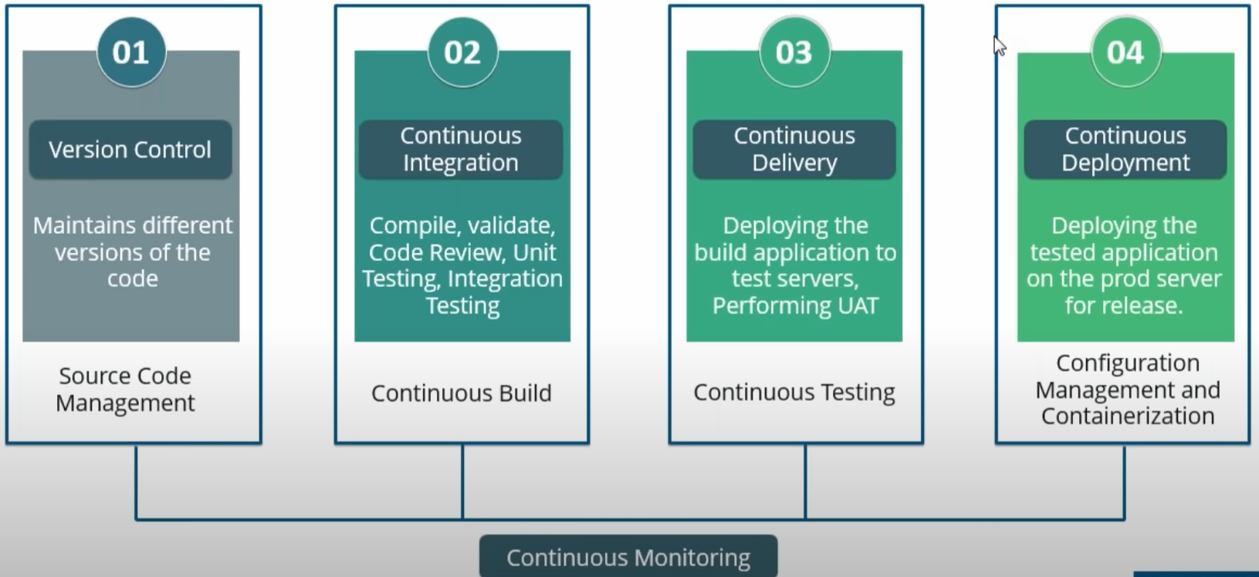
DevOps Stages
Notes:
Let me just take you through all these stages one by one starting from Version Control. So I'll be discussing all of these stages one by one as well.
14:46
But let me just give you an entire picture of these stages in one slide first. So Version Control is basically maintaining different versions of the code
14:54
what I mean by that Suppose there are multiple developers writing a code for a particular application. So how will I know
14:59
that which developer has made which commits at what time and which commits is actually causing the error
15:05
and how will I revert back to the previous commit so I hope you are getting my point my point here is how will I manage
15:11
that source code suppose developer day has made a commit and that commit is causing some error.
15:16
Now. How will I know the developer a has? That commit and at what time he made that comment and very the code was that editing happened.
15:23
Right? So all of these questions can be answered. Once you use Version Control tools like git subversion, etc.
15:30
Etc. We are going to focus on getting our course. So then we have continuous integration. So continuous integration is basically building
15:36
your application continuously what I mean by that suppose any developer made a change the source code a continuous integration server should be able
15:43
to pull that code. I am prepared a built now when I say build people have this misconception of you know,
15:48
only compiling the source code. It is not true guys includes everything starting from compiling your source code
15:53
validating your source code code review unit, testing integration, testing, etc, etc. And even packaging your application as well.
16:00
Then comes continuous delivery. Now the same continuous integration tool that we are using suppose Jenkins.
16:06
Now what Jenkins will do once the application is built. It will be deployed onto the test servers for testing to perform, you know,
16:13
user acceptance test or end user testing whether you call it there will be using tools like selenium right for performing.
16:19
Investing and once that is done, it will be then deployed onto the process servers for release,
16:24
right that is called continuous deployment and here we'll be using configuration management and containerization tools.
16:30
So this is basically to provision your infrastructure to provision your prod environment and let me tell you guys continuous deployment is something
16:36
which is not a good practice because before releasing a product in the market, there might be multiple checks that you want to do before that right?
16:43
There might be multiple other testing that you want to do. So you don't want this to be automated right? That's why continuous deployment is something
16:50
which is not preferred after continuous delivery. We can go ahead and manually use configuration management tools
16:55
like puppet chef ansible and salts tag, or we can even use Docker for a similar purpose and then we can go ahead and deploy it
17:01
onto the Crossovers for release. And once the application is live. It is continuously monitored by tools like Nagi iOS or Splunk,
17:08
which will provide the relevant feedback to the concern teams, right? So these are various stages involved in devops or is it is
17:15
17:45
I’ll repeat this entire slide once more so definitely to give you a better idea
17:50
So let's start with Version Control. So you have got the requirement from the client you have designed it how your application is going to look like.
17:57
You know that now what you have you have ten developers were writing code for that particular application right.
18:02
Now those ten developers are writing code, but how will we manage that code? So what my point here is
18:07
how will I know which come it has caused that error, which commits has caused a particular error or who has made which commits
18:14
at what time right to answer all of these questions? We use Version Control tools like git Subversion, etc, etc.
18:20
Right. So these tools will maintain different versions of the code. So even if you know, I want to revert back to the previous commit I
18:27
can go ahead and do that right? I can go ahead and check out the previous version of the code as well. That is what basically source code management
18:34
or Version Control is then comes continuous integration. So here continuous integration tools like Jenkins
18:40
what they do the continuously build your application when I say build includes compile validate code review unit testing integration testing and even,
18:48
you know packaging your application, so that comes under continuous integration continuously building your application
18:54
once continuous build is done you then deploy it onto the test servers for end user testing or user acceptance test
19:00
where you use tools like selenium that is called continuous delivery.
19:06
I hope I'm clear. All right. I just fine with it next what happens you deploy
19:12
your application onto the process service for release. Once your application is tested successfully, right?
19:17
So this can also be automated but a list something which is not a good practice because you know before releasing a product in the market,
19:23
you need to perform certain other check. You need to Market your product the multiple things that you need to consider and
19:28
that is why continuous deployment is something which is not recommended now under this continuous deployment.
19:33
We have configuration management and containerization. So configuration management tools are basically Chef
19:38
puppet ansible and salt stock which can provision and deploy your application onto the broad service
19:43
and containerization is basically Docker containers which serves a similar purpose. Once your application is life.
19:49
It will be continuously monitored by tools like Nagi Os or Splunk, which will provide the relevant feedback
19:55
to the concern teams. So that's how DevOps works. So these are the various stages involved in develops, right?
20:01
So now let me just go back to clear if there are loads. So this is our various stages are scheduled various jobs schedule.
20:07
So we Jenkins here. We have a continuous integration server. So what Jenkins will do the moment any developer makes a change in the source code,
20:15
it will take that code and then it will trigger a built using tools like Maven or and of Gradle.
20:20
Once that is done. It will deploy it onto the test servers for testing for end user testing using tools like selenium j-unit Etc.
20:28
Then what happens it will automatically take that tested application and deploy it onto the process servers for release, right?
20:34
And then it is continuously monitored by tools. Like Nagi was plunky lkx cetera et cetera. So Jenkins is basically heart of devops life cycle.
20:42
It gives you a nice 360 degree view of your entire software delivery life cycle.
20:47
So with that UI you can go ahead and have a look how your application is doing currently right? We're in which stage it is in right now testing
20:55
is done or not. All those things. You can go ahead and see in the Jenkins dashboard right? There might be multiple jobs running in the Jenkins dashboard
21:02
that you can see and it gives you a very good picture of the entire software delivery life.
21:08
Let's don't worry. I'm going to discuss all of these stages in detail when we move forward, right so till now any questions any doubts,
21:15
you have guys just feel free to ask me right now.
21:21
We are going to discuss each of these stages one by one starting from source code management or even call us Version Control.

Slide 12
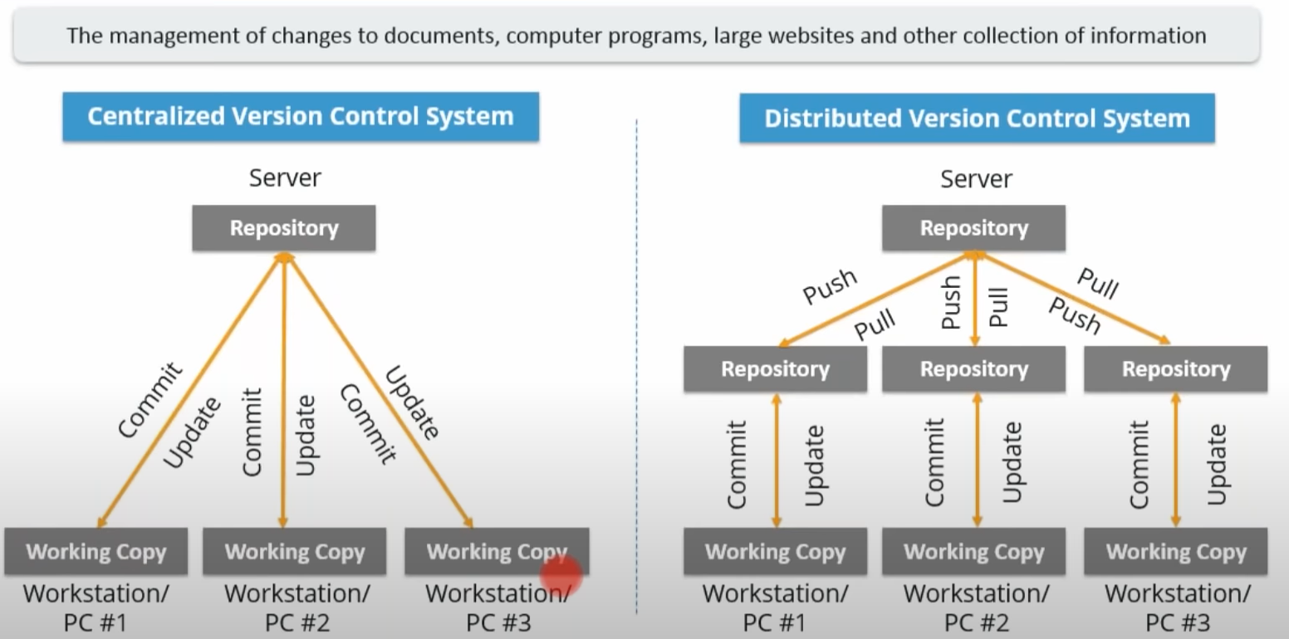
Source Code Management
Notes:
Now what happens in source code management, there are two types of source code management approaches one is called centralized Version Control.
21:34
And another one is called the distributed Version Control the source code management now, I imagine there are multiple developers writing a code
21:40
for an application if there is some bug introduced how will we know which come it has caused that error and how will I revert back to the previous version
21:47
of the code in order to solve these issues source code management tools were introduced and there are two types of source code management tools
21:53
one is called ventral eyes Version Control and another is distributed Version Control. So let's discuss the centralized Version Control first.
22:00
So centralized version control system uses a central server to store all the files and enables team collaboration.
22:06
It works in a The upholstery to which users can directly access a central server. So this is what happens here guys.
22:12
So every developer has a working copy the working directory. So the moment they want to make any change in the source code.
22:18
They can go ahead and make a comment in the shared repository right and they can even update their working copy by, you know,
22:24
pulling the code that is there in the repository as well. So the repository then the diagram that your nose noticing indicates a central server
22:31
that could be local or remote, which is directly connected to each of the programmers workstation. As you can see now every programmer can extract
22:39
or update their workstation or the data present in the repository or can even make changes to the data or committed
22:45
in the repository. Every operation is performed directly on the central server or the central repository,
22:51
even though it seems pretty convenient to maintain a single repository, but it has a lot of drawbacks,
22:56
but before attacking the drawbacks, let me tell you what advantage we have here. So first of all, if anyone makes a comment in the repository,
23:03
then it will be a commit ID Associated to it, and there will always be a commit message. So, you know,
23:08
which person has made that comment at net what time and where in the code basically, right so you can always revert back but let me
23:16
now discuss few disadvantages. First of all, it is not locally available. Meaning you always need
23:21
to be connected to a network to perform any action. It is always not available locally, right? So you need to be connected with the some sort of network.
23:29
Basically since everything is centralized in case of the central server getting crashed or corrupted.
23:34
It will result in losing the entire data of the project. Right? So that's a very serious issue guys.
23:39
And that is one of the reasons why Industries don't prefer centralized Version Control System, that's talk about the distributed version control system.
23:46
Now now these systems do not necessarily rely on a central server to store all the versions of the project file.
23:52
So in distributed Version Control System, every contributor has a local copy or clone of the main repository as you can see,
23:59
I'm highlighting with my cursor right now that is everyone maintains a local repository of their own
24:04
which contains all the files and metadata present in them. In repository as you can see then the diagram is well,
24:10
every programmer maintains a local repository on its own which is actually the copy or clone of the central repository on their hard drive.
24:17
They can commit and update the local repository without any interference. They can update the local repositories
24:23
with new data coming from the central server by an operation called pull and effect changes
24:29
to the main repository by an operation called push right operation called push from the local repository.
24:36
Now the USB thinking what advantage we get here, what are the advantages of distributed version control
24:41
over the centralized Version Control now basically the act of cloning and entire repository gives you that Advantage.
24:47
Let me tell you how now all operations apart from push-and-pull are very fast because the tool only needs to access the hard drive
24:55
not a remote server, hence, you do not always need an internet connection committing new change sets can be done locally
25:01
without manipulating the data on the main proposed three. Once you have a group of change sets ready you
25:07
can put Them all at once. So what you can do is you can ask the commit to your local repository, which is there in your local hard drive.
25:14
You can commit the changes. That you want in the source code you can you know Bunch review it and then
25:19
once you have quite a lot of change sets ready, you can go ahead and push it onto the central server as well
25:25
at the central server gets crashed at any point of time. The lost data can be easily recovered from any one
25:30
of the contributors local repository. This is one very big Advantage about from that since every contributor has a full copy
25:38
of the project repository. They can share changes with one another if they want to get some feedback before affecting the changes in the main repository as well.
25:45
So these are the various ways in which you know distributed version control system is actually better than a centralized version control system.
25:52
So we saw the two types of source code management systems and I hope you have understood it. We are going to discuss
25:57
a one source code management tool called gate, which is very popular in the market right now almost all the companies actually use get so
26:04
before I move ahead if you have any questions or doubts, you can just go ahead and ask any questions guys
26:10
What are the different source code management tools? There are a lot actually there is bitbucket.
26:16
There is subversion there's get and if you talk about the most famous one then that is definitely get so I hope this answers your question.
26:25
26:31
I'll move forward and we'll go into focus on a source code management tool a distributed Version Control tool that is called
26:37
as get now before I move forward guys. Let me make this thing clear.

Slide 13
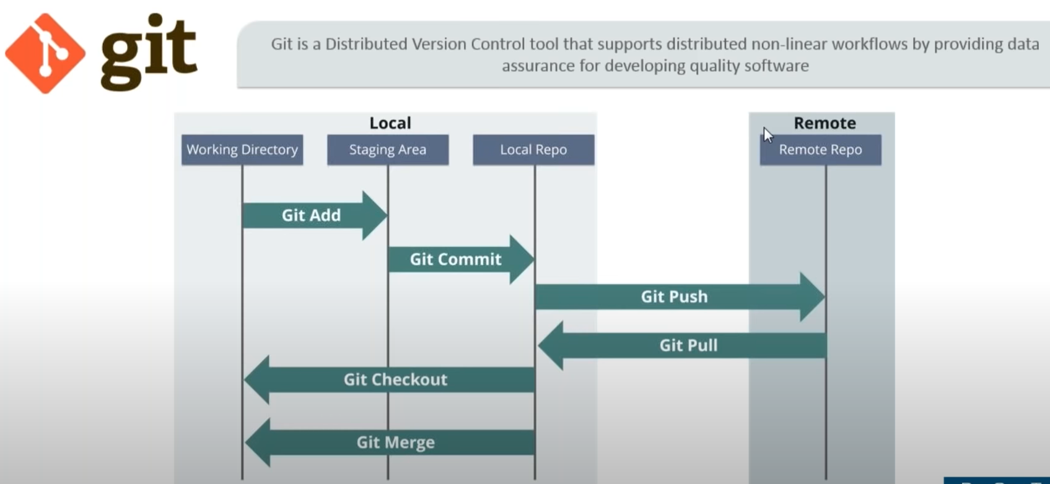
Source Code Management
Notes:
So when I say Version Control of source code management,
26:42
it's one of the same thing. Let's talk about get now now git is a distributed Version Control tool
26:47
that supports distributed nonlinear workflows by providing data Assurance for developing quality software, right?
26:54
So it's a pretty tough definition to follow but it will be easier for you to understand with the diagram that is there in front of your screen.
27:00
So for example, I am a developer and this is my working directory right now. What I want to do is I want to make some changes
27:07
to my local repository because it is a distributed Version Control System. I have my local repository as well.
27:13
So what I'll do I'll perform a git add operation now because of git add whatever was there in my working directory will be present in the staging area.
27:20
Now, you can visualize the staging area as something which is between the working directory. Your local repository, right?
27:27
And once you have done get ad you can go ahead and perform git commit to make changes
27:32
to your local repository. And once that is done you can go ahead and push your changes to the remote repository as well.
27:39
After that. You can even perform get pull to add whatever is there in your remote repository to your local repository
27:44
and perform get check out to add everything which was there in your local repository to your working directory as well.
27:50
All right. So, let me just repeat it once more for you guys. So I have a working directory here. Now in order to add that to my local repository.
27:57
I need to First perform get add that will add it to my staging area staging area is nothing but area between the working directory
28:04
and the local repository after get a lie can go ahead and execute git commit which will add the changes to my local repository.
28:11
Once that is done. I can perform get push to push the changes that I've made in my local repository to the remote repository and in order to pull other changes
28:18
which are there in the remote repository of the local repository. You can perform get pull and finally get check out that will be added to your work.
28:25
. Now, if you want to learn more about get I'll leave the link
28:32
in the chat box. You can go ahead and have a look at that video.. Let me just show you a few basic commands of get
28:42
so I've already installed get in my Center as virtual machine. And if you have any problems installing it, you can refer the get installation video.
28:49
I'll leave the link in the chat box and similarly the people who are watching it on YouTube can find it in the description box below right?
28:55
So, let me just quickly open my centaurs virtual machine to show you a few basic operations that you can perform
29:01
with get device virtual machine and I've told you that I've already installed get now in order to check the version of get you can just type in
29:08
here get - - version and you can see that I have two point seven point two here.

Slide 14
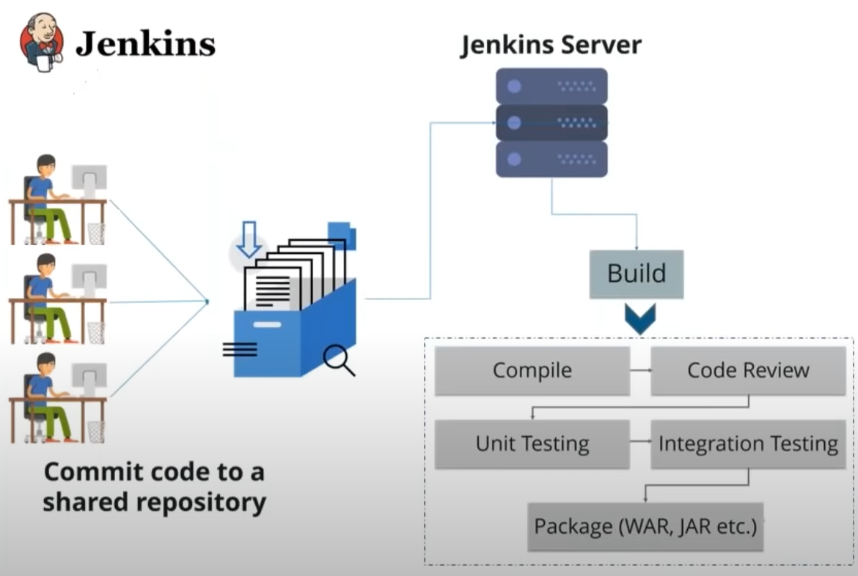
Continuous Integration
Notes:
So continuous integration is basically a development practice
34:04
in which the developers are required to commit changes. Just the source code in a shared repository several times a day,
34:10
or you can say more frequently and every commit made in the repository is then built this allows the teams to detect the problems early.
34:17
So let us understand this with the help of the diagram that is there in front of your screen. So here we have multiple developers
34:22
which are writing code for a particular application and all of them are committing code to a shared repository
34:27
which can be a git repository or subversion repository from there the Jenkins server, which is nothing but a continuous integration tool
34:34
will pull that code the moment any developer commits a change in the source code the moment any developer coming to change
34:40
in the source code Jenkins server will pull that it will prepare a build now as I have told you earlier as well build does not only mean compiling the source code.
34:48
It includes compiling but apart from that there are other things as well. For example code review unit testing integration testing,
34:55
you know packaging your application into an executable file. It can be a war file. It can be a jar file.
35:00
So it happens in a continuous manner the moment any developer coming to change in the source code Jenkins over will pull
35:05
that prepare a bill. Right. This is called as continuous integration. So Jenkins has various Tools in order to perform this
35:12
so it has various tools for development testing and deployment Technologies. It has well over 2,500 plugins.
35:18
So you need to install that plug-in and you can just go ahead and Trigger whatever job you wanted with the help of Jenkins.
35:24
It is originally written in Java. Right and let's move forward and we are going to focus on continuous delivery now,

Slide 15
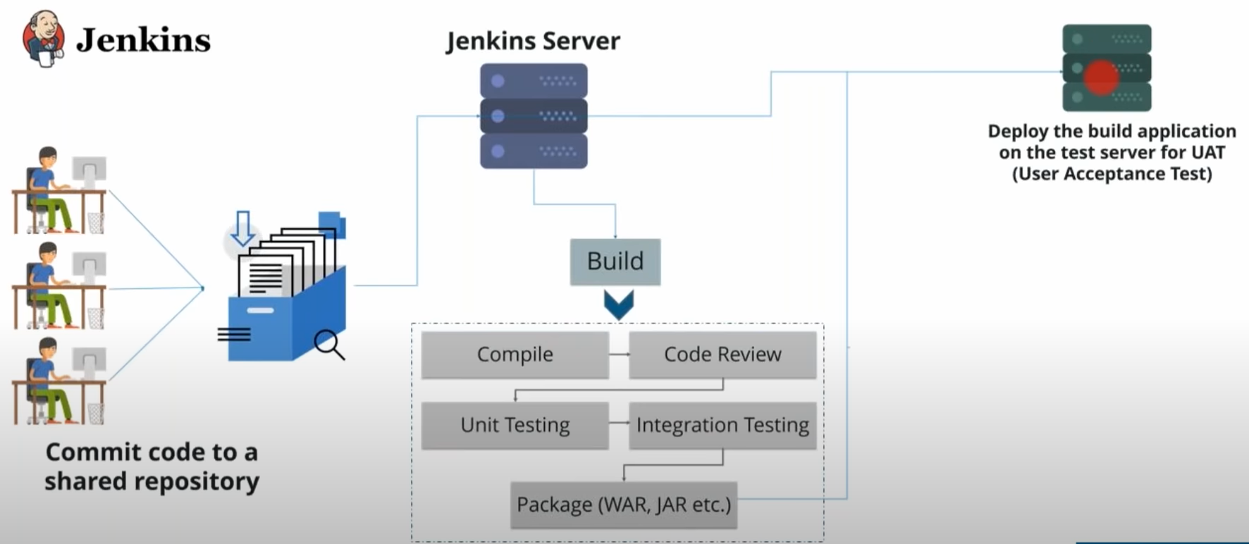
Continuous Delivery
Notes:
so continuous delivery is nothing but taking continuous integration to The Next Step. So what are we doing
35:35
in a continuous manner or in an automated fashion? We are taking this build application onto the test server for end user testing or unit
35:43
or user acceptance test, right? So that is basically what is continuous delivery. So let us just summarize continuous delivery again moment.
35:50
Any developers makes a change in the source code. Jenkins will pull that code prepare a built once build is successful.
35:56
It will take the build application and Jenkins will deploy it onto the test server for end user testing
36:02
or user acceptance test. So this is basically what continuous delivery is is happens in a continuous fashion.
36:07
So what advantage we get here? Basically if they the build failure then we know which commits has caused that error
36:13
and we don't need to go through the entire source code of the application similarly for testing even
36:19
if any bug appears in testing is well, we know which comment has caused that are Ernie can just go ahead and you know have a look at that particular comment
36:26
instead of checking out the entire source code of the application. So they basically this system allows the team to detect problems early,
36:33
right as you can see from the diagram as web. You know, if you want to learn more about Jenkins, I'll leave a link in the chat box.
36:38
You can go ahead and refer that and people are watching it on YouTube can find that link in the description box below now,
36:44
we're going to talk about continuous deployment. So continuous deployment is basically taking the application
36:49
the build application that you have tested and deploying that onto the process servers for release in an automated fashion.
36:55
So once the application is tested it will automatically be deployed on to the broad service for release. Now, this is something not a good practice
37:01
as I've told you earlier as well because there might be certain checks that you need to do now to release your software in the market.
37:07
How do you might want to Market your product before that? So there's a lot of things that you want to do before deploying your application.
37:13
So it is not advisable or a good practice to you know, actually automatically deploying your application
37:18
onto the processor which for release so this is basically continuous integration delivery and deployment any questions.
37:23
You have guys you can ask you. All right. So Dorothy wants me to repeat it. Once more sure jovial do that.
37:28
Let's start with continuous integration. So continuous integration is basically committing the changes in the source code more frequently
37:36
and every commit will then be built using a Jenkins server, right or any continuous integration server.
37:41
So this Jenkins water will do it will trigger a build the moment any developer commits a change in the source code and build includes of compiling code review unit,
37:48
testing integration testing packaging and everything. So I hope you are clear with what is continuous integration.
37:53
It is basically continuously building your application, you know, the moment any developer come in to change in the source code.
37:59
Jenkins will put that code in prepare a belt. So I have a question popped in my screen. This is from Jessica. What do you exactly mean by unit and integration testing?
38:06
All right. Well, let me just explain you that with an example of a pain what happens when you are manufacturing a pain in the factory.
38:13
It will be manufactured in small small pieces the cab the body and all those things right? So checking if the functioning
38:19
of those small small pieces basically the unit testing and then integrating multiple pieces together and then testing is
38:25
what is called integration testing. I hope this answers your question the same goes for your software as well.
38:31
All right, so she's fine with the answer. Let's move forward and now I'm going to explain you continuous
38:37
delivery now incontinence delivery the package that we have created here the war of the jar file of the executable file.
38:43
Jenkins will take that package and it will deploy it onto the test server for end user testing. All right.
38:49
So this one more question from geography again, which kind of testing are you talking about now fine. So this kind of testing is called the end user testing
38:56
of user acceptance test where you need to deploy your application onto a server which can be a replica of your production server
39:03
and you perform end user testing or you call it user acceptance test. For example My application if I want to check
39:08
all the functions right functional testing if I want to perform functional testing of my application. I will first go ahead and check
39:13
whether my search engine is working then I'll check whether people are able to log in or not. So all those functions of a website
39:18
when I check or an application and I check is basically after deploying it on to apps over right? So that's sort
39:24
of testing is basically what is your functional testing or what? I'm trying to refer here. So I hope you are clear.
39:29
All right, she's finally answer next up. We are going to continuously deploy our application
39:34
onto the broad servers for release. So once the application is tested it will be then deployed onto the processor was
39:40
for release and I've told you earlier is well, it is not a good practice to deploy your application continuously or in an automated fashion.
39:46
All right, fine guy. So any other questions any other doubts related to integration delivery and deployment?

Slide 16
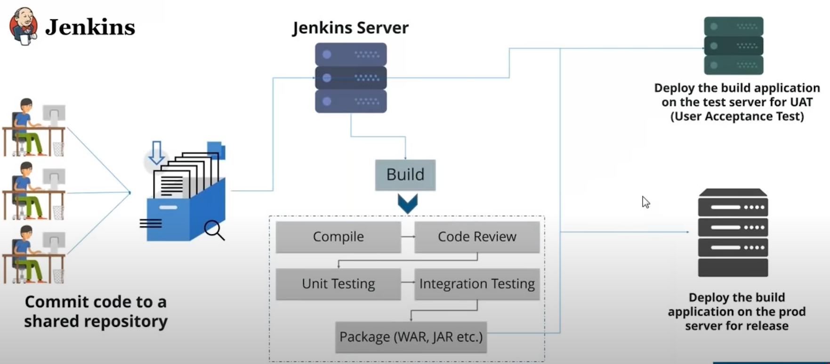
Continuous Deployment
Notes:
All right. So there's a question of popped on my screen. It is from shubham. He's asking can you explain a bit more
39:57
about Jenkins fine sebum? So Jenkins is basically a continuous integration tool and its job is to integrate the various stages of develops
40:04
that we have discussed, right? So we discussed First we manage the source code then we build it test it deployed
40:11
and monitor it so Jenkins server or the Jenkins continuous integration tool will actually
40:16
integrate all of these stages. Now what it does it will give you a nice UI basically that you I will contain
40:22
the entire software delivery life cycle that will give you the 360-degree view of your entire software delivery life cycle.
40:28
Where is my application right now? Whether tests were successful is it deployed onto the broad environment successfully all those things.
40:34
You can find it in the Jenkins dashboard. If you want to visualize it consider it as you know, you have been an orchestra over there.
40:40
You'll find this one guy who has a stick in one hand and rest of the people are playing the instruments, right? So that's what Jenkins is
40:46
it will trigger different different jobs. It will trigger different phases of devops life cycle with the help of various plugins
40:52
that Jenkins support. I hope that's clear. So I believe I've answered all the questions. So guys you have discussed a lot about Jenkins.
40:58
How about I show you how Jenkins UI looks like and how you can download plugins on all those things.
41:03
So I've already installed Jenkins in my Center is virtual. And if you have any problems installing Jenkins, refer the video
41:09
that I will ping you in the chat box and people are watching it on YouTube can find it in the description box below.

Slide 17
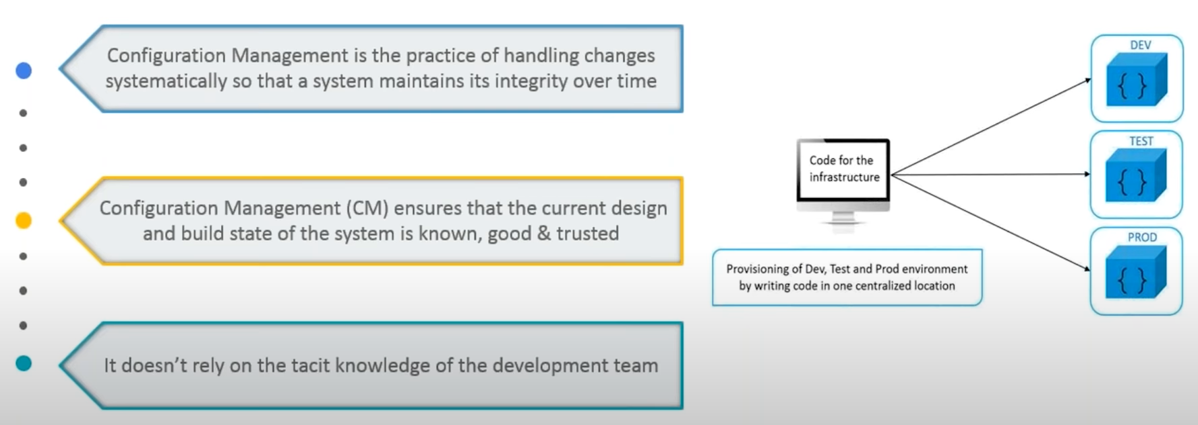
Configuration Management
Notes:
So now let's talk about configuration management. So what exactly is configuration management, so now let me talk about few issues with the deployment
43:01
of a particular application or provisioning of the server's so basically what happens, you know. I've built my application,
43:07
but when I deploy it onto the test servers or onto the process servers, there are some dependency issues because I wish my application is not working fine.
43:14
For example in my developers laptop. There might be some software stack which was upgraded but in my prod and in the test environment,
43:21
they're still using the outdated version of that software side because of which the application is not working fine.
43:26
This is just one example apart from that what happens when your application is life and it goes down because of some reason
43:32
and that reason can be you have upgraded the software stack. Now, how will you go back to the previous table version
43:37
of that software stack. So there are a lot of issues with you know, the admin side of the company the upside of the company
43:42
which were removed with the help of configuration management tools. So, you know before that means you should write
43:48
these long script in order to provision the infrastructure whether it's the test environment of the prod environment of the dev environment.
43:54
So these light those long scripts right which is prone to error plus. It used to take a lot of time and apart from that the Edmund who has written that script.
44:01
No one else can actually recognize what's the problem with it once you if you have to debug it, so there are lot of problems
44:06
that were there with the admin side or the observe the company which were removed by the help of configuration management tools and when very important concept
44:13
that you guys should understand is called infrastructure as code which means that writing code for your infrastructure.
44:19
That's what it means suppose if I want to install lamp stack on all of these three environments whether it's devtest abroad I will write the code
44:25
for installing lamp stack in one central location and I can go ahead and deploy it onto devtest and product.
44:31
So I have the record of the system State president my one central location, even if I upgraded to the next version,
44:38
I still have the record the previous stable version of the software stack, right so I don't have to manually go ahead
44:44
and you know write scripts and Right onto the nodes this is that easy guys. So let me just focus on few challenges
44:50
at configuration management helps us to overcome. First of all, it can help us to figure out which components to change
44:56
when requirements change. It also helps us in redoing an implementation because the requirements
45:02
have changed since the last implementation and very important Point guys that it helps us to revert to a previous version
45:07
of the component if you have replaced with a new but the flawed version now, let me tell you the importance of configuration management
45:13
through a use case now the best example I know is of New York Stock Exchange a software glitch prevented the NYC from Trading stocks
45:22
for almost 90 minutes this led to millions of dollars of loss a new software installation
45:27
cause the problem that software was installed on eight of its twenty trading Terminals and the system was tested out the night before however
45:35
in the morning it failed to operate on the a term ends. So there was a need to switch back to the old software
45:40
now you might think that this was a failure of nyc's configuration management process, but in Reality,
45:46
it was a success as a result of proper configuration management NYC recovered from that situation in 90 minutes,
45:53
which was pretty fast had the problem continued longer. The consequences would have been more severe guys.
45:59
So I hope you have understood its importance. Now, let's focus on various tools available for configuration management.

Slide 18
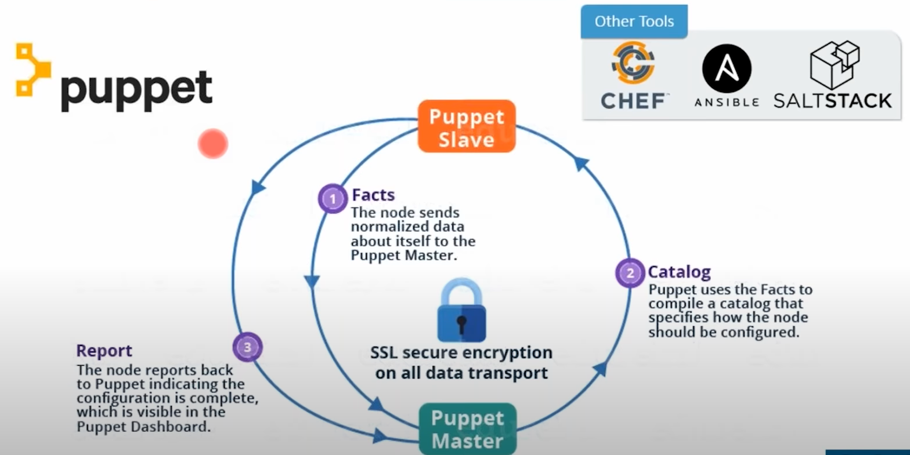
Configuration Management(cont.)
Notes:
So we have multiple tools like puppet Chef Anne surveillance all stock. I'm going to focus on pop it for now. So pop it is a configuration management tool that is used
46:11
for deploying configuring and managing servers. So, let's see, what are the various functions of puppet.
46:16
So first of all, you can Define distinct configurations for each and every host and continuously check and confirm
46:23
whether the required configuration is in place and is not altered on the host. So what I mean by that you
46:29
can actually Define this thing configuration for example in my one particular node. I need this office.
46:34
I can another node. I need this office stack so I can you know, defined distinct configurations for different nodes and continuously check and confirm
46:42
whether the required configuration is in place and is not alter. And if it is altered puppet will revert back
46:48
to the required configurations. This is one function of puppet. It can also help in Dynamic scaling up and scaling down of machines.
46:54
So what will happen if in your company there's a big billion day sale, right and you're expecting a lot of traffic.
46:59
So at that time in order to provision more servers probably today our task is to provision 10 servers and tomorrow,
47:05
you might have to revision say 100 GM's right? So how will you do that? You cannot go ahead and do that manually
47:10
by writing scripts. You need tools like puppet that can help you in Dynamic scaling up and scaling down of machines.
47:16
It provides control over all of your configured machines. So our centralized change gets propagated to all automatically
47:22
so it follows a master-slave architecture in which the slaves will pull the central server for changes made in the configuration.
47:29
So we have multiple nodes there which are connected to the master. So they will pole they will check continuously.
47:34
Is there any change in the configuration happened the master the moment any change happen, it will pull that configuration
47:39
and deploy it onto that particular node. I hope you are getting my point. So this is called pull configuration and push configuration.
47:45
The master will actually push the configurations on to the nodes which happens in an civil and salts that but does not happen in pop it in shifts.
47:51
So these two tools follow pull configuration and an smellin salts that follows push configuration in which these configurations
47:57
are pushed onto the nodes and here in chef and puppet. The nodes will pull that configurations. They keep on checking the master at regular intervals.
48:05
And if there is any change in the configuration, it will pull now let me explain you the architecture that is there in front of your screen.
48:10
So that is basically a typical puppet architecture in which what happens you can see that there's a master-slave architecture here is
48:16
our puppet master and here is our puppet slave now the functions which are performed in this architecture first, the puppet agent sends the fact to the puppet master.
48:23
So this poppet slave will first send the fact to the Puppet Master farts what our Fox basically they are key value data pairs.
48:31
It represents some aspects of slave states such as its IP address of time operating system
48:36
or whether it's a virtual machine, right? So that's what basically facts are and the puppet master uses a fact to compile a catalog
48:44
that defines how the Slaves should be configured now. What is the catalog it is a document
48:49
that describes a desired state for each resource that Puppet Master manages. Honestly, then what happens the puppet slave reports back
48:58
to the master indicating that configuration is complete and which is also visible in the puppet dashboard.
49:04
So that's how it works guys. If you have any questions or doubts, you can go ahead and ask me. All right a shoe bomb is asking a question is asking can you
49:11
give me some tool examples with push-and-pull configuration? Well short so as I've told you that an sibilance all Stark uses the push configuration
49:18
in which you write the scripts or you write the configurations in one central location
49:24
that can be an eligible control machine, right or basically a master and from that Master suppose
49:30
you want to push those configurations on the 1502. You can go ahead and execute a command in the slave and push that onto as many notes
49:37
as you want. Let's talk about pole configurations. So in pull configuration, the nodes will actually pull the central server
49:44
for configurations at regular. It's it can be a puppet slave. It can be Puppet Master.
49:49
It can be a chef so chefs over so the nodes will pull the central server for you know,
49:54
configurations and it will pull any change that has happened in the configuration. So I hope you've understood it.
50:00
Just give me a confirmation shabam so that I can move forward. All right. He says yes all clear fine guys
50:06
so I can see there are no more questions. So let's move forward and talk about containerization.
50:12
So what exactly is containerization so I believe all of you have heard about virtual machines. So what are containers containers are nothing
50:19
but the lightweight alternatives to Virtual machines. So let me just explain that to you.

Slide 19
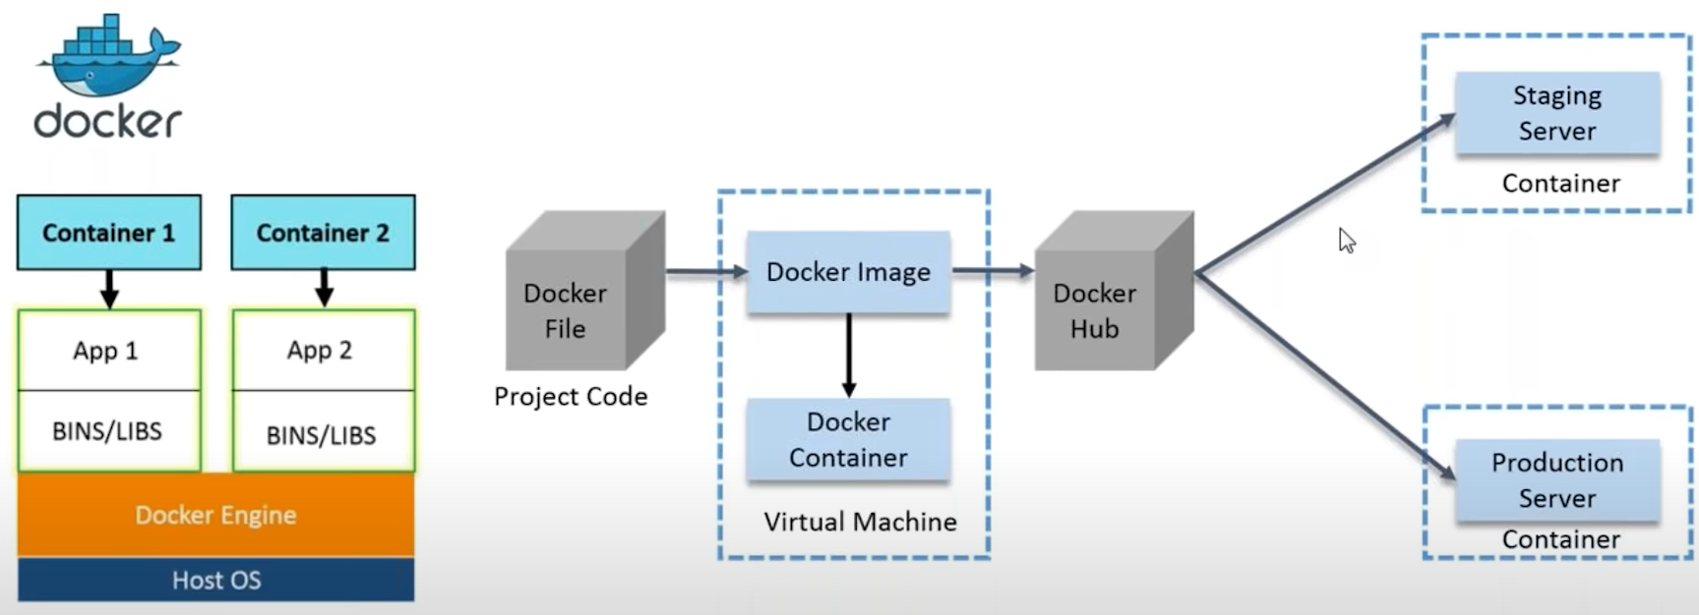
Containerization
Notes:
So we have Docker containers that will contain the binaries
50:27
and libraries required for a particular application. And that's when we call it. You know, we have containerized a particular application, right?
50:34
So let us focus on the diagram that is there in front of your screen. So here we have host operating system on top of which we have Docker engine.
50:40
We have a No guest operating system here guys. It uses the host operating system and we are learning
50:45
two containers container one will have application one and it's binaries in libraries the container to will have
50:51
application to and it's binaries and libraries. So all I need in order to run my application
50:56
is this particular container or this particular container? Because all the dependencies are already present in that particular container.
51:04
So what is basically a container it contains my application the dependencies of my application.
51:09
The binary is Ivory is required for that application. Is there in my container nowadays if you must have noticed
51:15
that even you want to install some software you will actually get ready to use Docker container, right? That is the reason because it's pretty lightweight
51:22
when you compare it with virtual machines, right? So let me discuss a use case how you can actually use Docker in the industry.
51:28
So suppose you have some complex requirements for your application. It can be a microservice. It can be a monolithic application anything.
51:35
So let's just take microservice. So suppose you have complex requirements for your microservice your you have written the dockerfile
51:41
for them with the help of this Docker 5. I can create a Docker image. So Docker image is nothing
51:47
but you know a template you can think of it as a template for your Docker container, right? And with the help of Docker image,
51:53
you can create as many Docker containers as you want. Let me repeat it once more so we have written the complex requirements
51:59
for a micro service application in an easy to write Docker file from there. We have created a doctor. It and with the help of Docker image we can build
52:06
as many containers as we want. Now that Docker image. I can upload that onto Docker Hub,
52:11
which is nothing but a git repository of Docker images we can have public repositories can have private repositories e
52:17
and from Docker Hub any team beat staging a production can pull that particular image and prepare as many containers
52:24
as they want. So what advantage we get here, whatever was there in my developers laptop, right? The Microsoft is application.
52:30
The guy who has written that and the requirement for that micro service obligation, so that guy's basically a developer and
52:37
because he's only developing the application. So whatever is there in my developers laptop, I have replicated in my staging as well as in the production.
52:44
So there's a consistent Computing environment throughout my software delivery lice egg. I hope you are getting my point.
52:50
Any questions you have any doubts. I'll actually open my Virtual Machine and I'll show you a few basics of Docker is well, but before that
52:56
if you have any questions anything in your mind, please feel free to ask me. Okay, the question popped in my screen.
53:02
What is the difference between virtual machines and Docker containers? So with the help of Docker containers,
53:07
you don't have to preallocate any Ram, right? It will take as and when required but in Virtual machines, you have to pre-allocate some amount of ram
53:14
because of which a lot of resources are wasted. So yeah, it's a lightweight alternative to Virtual machines. It doesn't work on the guest operating system.
53:21
It uses the host operating system the docker containers. So these are few differences which actually makes it better than virtual machines
53:28
and a lightweight alternative towards machines. Can I download Hadoop Docker image from doctoral
53:34
when I can run it? Well, definitely you can go ahead and start doing that. There is no stopping you if there is a Docker image
53:40
available on Docker hub for Hadoop. Let's try to pull it. Why not? So guys, let me just quickly brief you again about
53:47
what exactly a Docker containers so just visualize container as actually a box in which our application is present with all
53:54
its dependencies except the box is infinitely replicable. Whatever happens in the Box stays in the Box
54:00
unless you explicitly take something out or put something in and when it breaks you will just throw it
54:06
away and get a new one. So containers usually make your application easy to run on different computer.
54:11
Ideally the same image should be used to run containers in every environment stage from development to production.
54:17
So that's what basically Docker containers are. So guys. T
and I've already installed Docker if you want to learn how to install Docker just refer the link that helping you in the chat box.
54:29
Then the people who are watching it on YouTube can find it in the description box below. So the first thing is I need to start Docker for that.
54:36
I will type system CTL start docker.
54:42
Give the password. And I started successfully so now what I'm going to do,
54:47
there are few images which are already there in Docker Hub, which are public images. You can pull it at anytime you want.
54:54
Right? So you can go ahead and run that image as many times as you want. You can create as many containers as you want.
55:00
So basically when I execute the command of pulling an image from dog a rabbit will try to First find it locally whether it's present or not.
55:06
And if it is present then it's well and good. Otherwise, we'll go ahead and pull it from the docker Hub. So right so before I move forward,
55:12
let me just show you how Docker of looks like If you have not created
55:17
an account and Doctor have you need to go and do that? Because for executing a use case you have to do is it's free of cost.
55:23
So these are darker of looks like guys and this is my repository that you can notice here. Right? I can go ahead and search for images here as well.
55:30
So for example, if I want to search for Hadoop images, which I believe one of you asked so you can find
55:35
that we have Hadoop images present here as well. Right? So these are nothing but few images
55:41
that are there on Docker Hub. So I believe now I can go back to my terminal and execute few basic Docker command.
55:46
So the first thing that I'm going to execute is called Docker images which will give the list of all the images
55:51
that I have in my local system. So I have quite a lot of images you can see right
55:56
this is the size and and all those things when it was created the image. This is called the image ID, right?
56:03
So I have all of these things displayed on my console. Let me just clear my terminal now what I'm going to do,
56:08
I'm going to pull an image, right? So all I have to type here is the awkward pull for example
56:13
if I want to pull an Ubuntu image. Just type in hair darker pull open to and here we go.
56:19
So it is using default tag latest. So tag is something that I'll tell you later. But yeah, it will provide the default tag latest all the time.
56:26
So it is pulling from the docker Hub right now because it couldn't find it locally. So download is completed is currently extracting it.
56:34
Now if I want to run a container, all I have to type here is to occur and -
56:39
IIT Ubuntu or you can type the image ideas. Well, so I am in the Ubuntu container.
56:45
So I've told you how you can see the various Docker images of told you how you can pull an image from Docker Hub
56:50
and how you can actually go ahead and run a container. So if you want to know more about Docker, I'll leave a link in the chat box.
56:56
You can go ahead and have a look and people are watching it on YouTube can find it in the description box below for now.
57:01
Let's go back to our slides and you're going to focus on continuous monitoring now, so continuous monitoring tools
57:07
resolve any system errors, you know, what kind of system errors low memory unreachable server, etc, etc.

Slide 20
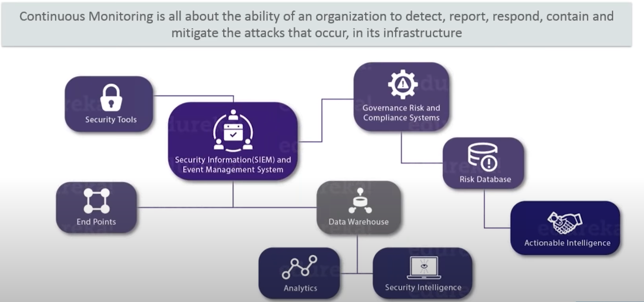
Continuous Monitoring
Notes:
resolve any system errors, you know, what kind of system errors low memory unreachable server, etc, etc.
57:14
Before they have any negative impact A business productivity now, what are the reasons to use continuous monitoring tools?
57:20
Let me tell you that it detects any network or server problems. It can determine the root cause
57:25
of any issue it maintains the security and availability of the services and also monitors in troubleshoot server performance issues.
57:32
It also allows us to plan for infrastructure upgrades before outdated system cause failures and it can respond to issues at the first sign
57:39
of problem and let me tell you guys these tools can be used to automatically fix problems when they are detected as well.
57:44
It also ensures it infrastructure outages have a minimal effect on your organization's bottom line
57:49
and can monitor your entire infrastructure and business processes. So what is continuous monitoring it is all about the ability
57:57
of an organization to detect report respond contain and mitigate that acts
58:02
that occur on its infrastructure or on the software. So basically we have to monitor the events
58:07
on the ongoing basis and determine what level of risk. We are experiencing. So if I have to summarize continuous monitoring
58:14
in one definition, I will say it is the integration of an organization security tools. So we have different security tools in
58:20
an organization the integration of those tools the aggregation normalization
58:26
and correlation of the data that is produced by the security tools right now.
58:31
It happens the data that has been produced the analysis of that data based
58:36
on the organization's risk goals and threat knowledge and near real-time response to the risk identified is basically
58:44
what is continuous monitoring and is a very good saying guys if you can't measure it, you can't manage it.
58:49
I hope you know what I'm talking about.

Slide 21
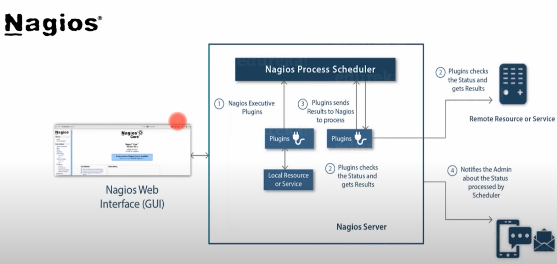
Continuous Monitoring(Nagios)
Notes:
Now, there are multiple continuous monitoring tools available in the market. We are going to focus on nagas now give us is used
58:56
for continuous monitoring of systems application services and business processes in a devops culture,
59:02
right and in the event of failure nagas can alert technical staff of the problem allowing them to begin the mediation process
59:08
before outages affect business processes and users or customers. So I guess you don't have to explain why
59:14
19 infrastructure outage affect your organization's bottom line. So let me tell you how it works. So I'll focus on the diagram
59:20
that is there in front of your screen. So now I give is runs on a server usually as a Daemon or a service it periodically runs plugins residing
59:28
on the same server. They contact holes or servers on your network so you can see it in the diagram as well.
59:34
It periodically runs plugins residing on the same server. They contact holes or servers on your network or on the Internet or Source overs,
59:42
which can be locally present. It can be remotely present as well one can view the status information using the web interface.
59:48
You can also receive email or SMS notification if something happens so now gives them and behaves like a scheduler
59:55
that runs out in scripts at certain moments. It stores the results of those Crypts and we'll run other scripts
1:00:00
if these results change now what our plugins plugins are compiled executables or scripts that can be run
1:00:06
from a command line to check the status of a host or service. So now use uses a results from the plugins determine
1:00:11
the Current status of the host and services on your network. So what happened actually in this diagram now
1:00:17
your server is running on a host and plugins interact with local or remote host right.
1:00:22
Now. These plugins will send the information to the scheduler which displays that in the gy that's what is happening guys.
1:00:29
So, I believe we all are clear with Naga is if you want to learn more about Nagi ways, I'll leave a link in the chat box.
1:00:34
You can go ahead and refer that block and the people are watching it on YouTube can find the link in the description box below.
1:00:40
All right, so we have discussed all the stages. So let me just give you a quick recap of what all things we have discussed first.
1:00:46
We saw what was the methodology before develops? We saw the waterfall model. What were its limitations then we understood the agile model
1:00:53
and the difference between the waterfall and the agile methodology and what are the limitations of agile methodology then we understood
1:00:59
how devops overcomes all of those limitations in what exactly is the worms. We saw the various stages and tools involved
1:01:05
in devops starting from Version Control. Then we saw continuous integration. Then we saw continuous delivery then we saw countenance.
1:01:11
Lyman basically, we understood the difference between integration delivery and deployment then we saw
1:01:17
what is configuration management and containerization and finally explained continuous monitoring.

Slide 22
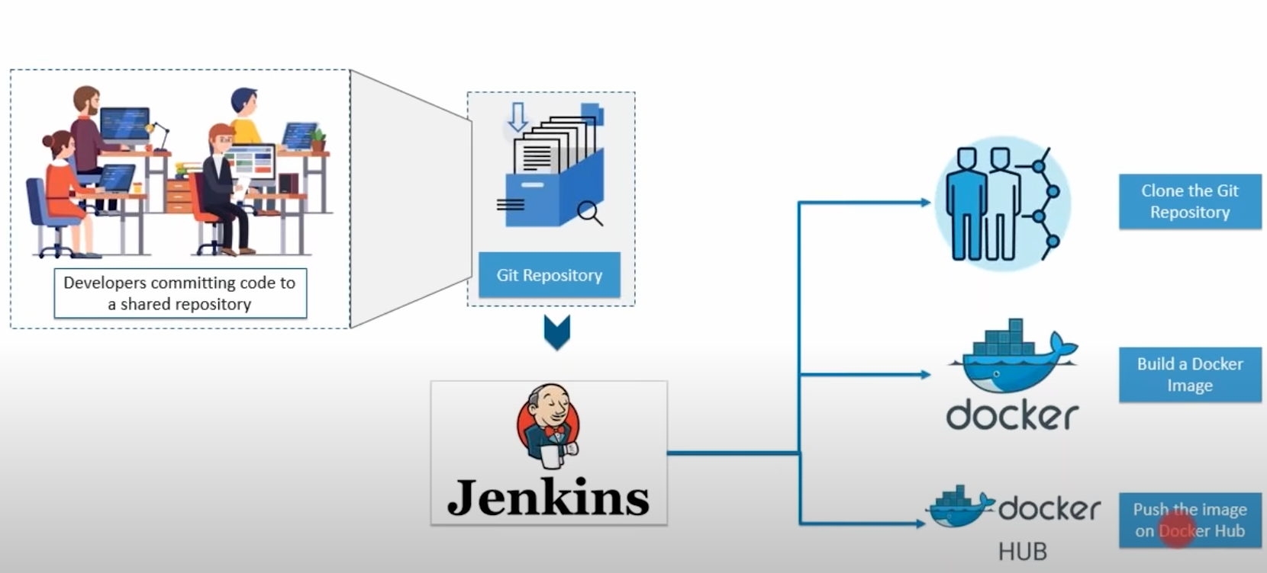
DevOps Use-Case Part-1
Notes:
So let's see what we are going to implement
1:01:35
in today's use case. So this is what we'll be doing. We have git repository, right? So developers will be committing code to this git repository.
1:01:42
And from there. Jenkins will pull that code and it will first clone that repository after cloning that repository it will build a Docker image
1:01:51
using a Docker file. So we have the dockerfile will use that to build an image. Once that image is built.
1:01:56
We are going to test it and then push it on to. Dr. How as I've told you what is the organ of is nothing but like a git repository of Docker images.
1:02:03
So this is what we'll be doing. Let me just repeat it once more so developers will be committing changes in the source code.
1:02:08
So the moment any developers commit to change in the source code. Gainesville clone the entire gate repository.
1:02:14
It will build a Docker image based on the dockerfile that will create and from there. It will push the docker image onto the docker Hub.
1:02:21
This will happen automatically with a click of a button. So what I'll do is we'll be using will be using gate Jenkins and Docker.
1:02:28
So let me just quickly open my Virtual Machine and I'll show you that.
1:02:35
So what our application is all about? So we are basically what creating a Docker image of a particular application
1:02:40
and then pushing it onto Docker Hub in an automated fashion. And our code is written in the GitHub repository.
1:02:45
So what is it application? So it's basically a Hello World server written with node. So we have a main dot JS.
1:02:51
Let me just go ahead and show you on my GitHub repository. Let me just go back.
1:02:59
So this is how our application looks like guys we have main dot J's right apart from that.
1:03:05
We have packaged or Json for a dependencies. Then we have Jenkins file and dockerfile Jenkins file.
1:03:10
I'll explain it to you what we are going to do with it. But before that let me just explain you few basics of Docker file and
1:03:16
how we can build a Docker image of this particular. Very basic node.js application. First thing is writing a Docker file now to be able
1:03:23
to build a Docker image with our application. We will need a Docker file. Yeah, right you can think of it as a blueprint for Docker.
1:03:29
It tells Docker what the contents in parameters of our image should be so Docker images are often based
1:03:34
on other images, but before that, let me just go ahead and create a Docker file for you. So let me just first clone this particular Repository.
1:03:47
So let me go to that particular directory first. It's there in downloads.
1:03:55
Let me unzip this first, unzip DevOps tutorial and let me hit an LS command.
1:04:00
So here is my application present. So I'll just go to this particular devops tutorial -
1:04:06
master and let me just say my terminal let us focus on what all files we have. We have dockerfile.
1:04:11
Let's not focus on Jenkins file at all for now, right we have dockerfile. We have made not just packaged
1:04:17
or Jason read me dot MD and we have test dot JS. So I have a Docker file with the help of which
1:04:23
I will be creating a Docker image, right? So let me just show you what I have written in this Docker file before this.
1:04:30
Let me tell you that Docker images are often based on other images right for this example.
1:04:35
We are basing our image on the official node Docker image. So this line that you are seeing is basically
1:04:41
to base our application on the official node Docker image. This makes our job easy and our dockerfile very very short guys.
1:04:48
So the in a hectic task of installing node, and it's dependencies in the image is already done in our basement.
1:04:54
So we'll just need to include our application. Then we have set a label maintainer. I mean, this is optional if you want to do it.
1:05:00
Go ahead. If you don't want to do it, it's still fine. There's a health check which is basically for Docker to be able to tell
1:05:07
if the server is actually up or not. And then finally we are telling Docker which Port ask server will run on right?
1:05:14
So this is how we have written the dockerfile. Let me just go ahead and close this and now I'm going to create an image using this Docker file.
1:05:21
So for that all I have to type here is pseudo. darker Bell slash home slash Edureka downloads devops -
1:05:36
tutorial basically the path to my dockerfile and here we go need to provide the sudo password.
1:05:43
So had I started now and is creating an image for me the docker image and it is done it successfully built and this is my image ID, right
1:05:52
so I can just go ahead and run this as well. So all I have to type here is Docker Run -
1:05:57
it and my image ID and here we go. So it is listening at Port 8000.
1:06:04
Let me just stop it for now. So I've told you how you can create an image using Docker file right now.
1:06:10
What I'm going to do, I'm going to use Jenkins in order to clone a git repository then build an image
1:06:16
and then perform testing and finally pushing it onto Docker Hub my own chakra profile.
1:06:21
All right, but before that what we need to do is we need to tell Jenkins what our stages are
1:06:26
and what to do in each one of them for this purpose. We will write Jenkins pipeline specification
1:06:31
in on Jenkins file. So let me show you how the Jenkins file looks like this click on it.
1:06:37
So this is what I have written in my Jenkins file, right? That's pretty self-explanatory first.
1:06:42
I've defined my application. I mean just clone the repository that I have then build that image.
1:06:47
This is the target I'm using a draca one, which is username. And Erica is the repository name right?
1:06:52
The Builder image then test it so we are just going to print test passed and then finally push it onto Docker Hub, right?
1:06:59
So this is the URL of Docker Hub and my credentials are actually saved in Jenkins in Docker Hub credentials.
1:07:05
So, let me just show you how you can save those credentials. So go to the credentials tab,
1:07:11
so here you need to click on system and click on global credentials. Now over here, you can go ahead
1:07:16
and click on update and you need to provide your username your password and your doctor have credential ID
1:07:22
that whatever you gonna pass there, right? So, let me just type the password again.
1:07:29
All right. Now we need to tell Jenkins two things where to find our code
1:07:35
and what credentials to use to publish the docker image, right? So I've already configured my project.
1:07:40
Let me just go ahead and show you what I have written there. So the first thing is the name of my project right which I was showing you when you create a new item over there.
1:07:48
There's an option called where you need to give the name of your project and I've chosen pipeline project. So if I have to show you the pipeline project
1:07:55
you can go to new item. And this is what I've chosen that the kind of project and then I have clicked
1:08:00
on Bill triggers. So basically this will pull my CM the source code management repository after every minute Whenever there is a change
1:08:07
in the source code will pull that and it will repeat the entire process after every minute then Advanced project options
1:08:14
are selected the pipeline script from SCM here either you can write pipeline script directly or you can click on Pipeline script
1:08:21
from source code management that kind of source code management is get then I've provided the link to my repository
1:08:26
and that's all I have done now when I scroll down there's nothing else I can just click on apply
1:08:31
and Save So I've already build this project one. So let me just go ahead and do it again.
1:08:36
All right side. I started first. It will clone the repository that I have. You can find all the logs. Once you click on this blue color ball
1:08:43
and you can find the logs here as well. So once you click here, you'll find it over here as well.
1:08:48
And similarly the logs are present here also, so now I we have successfully build our image.
1:08:54
We have tested it now. We are pushing it onto Docker hub.
1:09:00
So we are successfully pushed our image onto Docker Hub as well. Now if I go back to my profile and I go to my repository here.
1:09:12
So you can find the image is already present here have actually pushed it multiple times. So this is how you will execute the Practical.
1:09:18
It was very easy guys. So let me just give you a quick recap of all the things we have done first. I told you how you can write a Docker file in order
1:09:25
to create a Docker image of a particular application. So we were basing our image on the official node image
1:09:31
of present of the docker Hub, right which already contains all the dependencies and it makes a Docker file looks very small after that.
1:09:37
I build an image using the dockerfile then I explain to you how you can use Jenkins in order to automate the task
1:09:43
of cloning a repository then building a Docker image testing the docker image and then finally uploading the add-on to the docker Hub.
1:09:49
We did that automatically with the help of Jenkins a told you where you need to provide the credentials what our tags
1:09:55
how you can I Jenkins file the next part of the use cases different teams beat staging and production can actually pull the image
1:10:01
that we have uploaded onto Docker Hub and can run as many containers as you want. So that's it from today's session guys.
1:10:07
If you have any questions or doubts, you can go ahead and ask me. Any questions guys Siobhan says nice session.
1:10:14
So does Jessica fiance's really enjoyed it Quinn says very informative. I'm glad you all think that it was useful.
1:10:21
If you're looking for online structured training on devops. You can check out this particular URL www.edureka.co/devops
1:10:32
you'll find all the necessary details present here. The batch timings instructors a course curriculum the course description projects,
1:10:39
which will be the part of the training program how the certificate will look like

Slide 23
